Slide 1
Week 8 (1) – Heaps and Heapsort
CST370 – Design & Analysis of Algorithms
Dr. Byun
Computer Science

Slide 2
Lecture Objectives
After completion of this lecture, you will be able to
  recall the definition of a heap and heap operations.
  represent a heap in an array.

Slide 3
Chapter 6: Transform-and-Conquer
6.1 Presorting
6.2 Gaussian Elimination
6.3 Balanced Search Trees
6.4 Heaps and Heapsort
6.5 Horner’s Rule and Binary Exponentiation
6.6 Problem Reduction

Slide 4
<<< Course Instruction >>>
To recall the definition of heap and heap operations, review the lecture note “week_7_2.ppt” again.

Slide 5
Heap Representation in an Array
We can represent the heap of n nodes as an array of size n + 1.
  We do not use the index 0.
  We store the heap in the array from the index 1 to n.
    The root node is assigned to the index 1 of the array.
    All following nodes are stored to the indexes 2 through n.

Slide 6
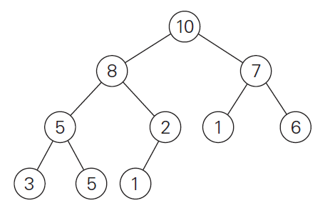

Heap Representation – Example
There are 10 nodes in the sample heap.
You store the heap of 10 nodes in the array of size 11 (= index 0 to index 10)
  Note that we don’t use the index 0.

Slide 7
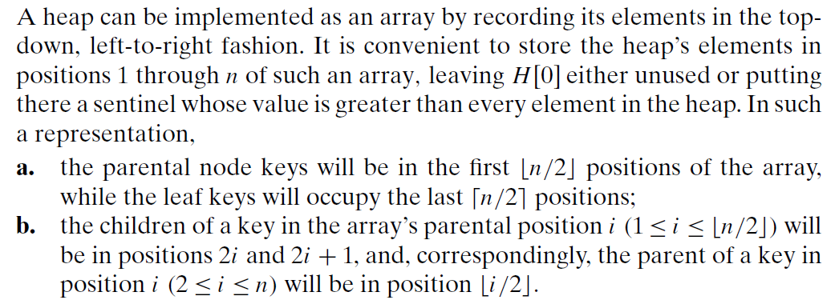
Heap Representation in an Array

Slide 8
Heap Construction
So far, we have assumed that the heap is already given.
But if we have n random input numbers, how can we construct the heap with the numbers?
  One simple idea is to add n numbers one by one.
    We call it top-down heap construction.
  Another idea is a button-up approach that offers better time complexity.
    We will talk about this approach in the class.

Slide 9
<<< Course Instruction >>>
Watch this video to understand how to create a max heap with n numbers.
  https://goo.gl/7TMHt6
  Watch it from the beginning to 3:27.
  Time analysis is difficult. So, skip it.

Slide 10
Heap Construction Example (1 of 4)
Assume that we have 6 numbers
  2, 9, 7, 6, 5, 8.
Let's construct a heap with the numbers.
  First, we should put the numbers in sequence like below.
2
9
7
6
5
8

Slide 11
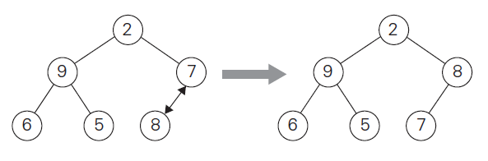
Heap Construction Example (2 of 4)
From the result, we know that the nodes 2, 9, and 7 are non-leaf nodes, which mean they have children.
  We start from the last non-leaf node (= 7).
  Since its child (= 8) is larger than 7, we swap them (= “heapify”).

Slide 12
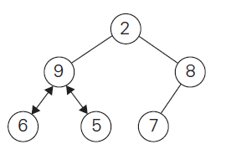
Heap Construction Example (3 of 4)
Since the next non-leaf node is 9, we try to “heapify” from the node.
  But the number 9 is larger than its children 6 and 5, we don’t do any swapping.

Slide 13
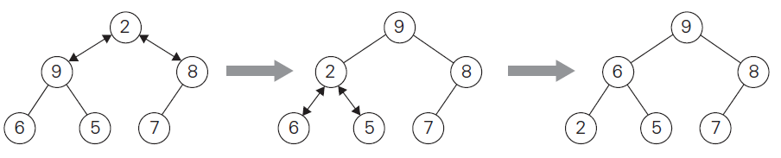
Heap Construction Example (4 of 4)
Now, we should consider the node 2 and “heapify” from the number.
  Since 9 is a bigger child, we swap 9 and 2.
  After the swapping, since 2 is less than its children, we need one more swapping.
  We swap 2 and 6 because 6 is bigger than 5.

Slide 14
<<< Course Instruction >>>
This is an optional video.
  Skip this if you think you have a thorough understanding of how to construct a heap with n numbers.
  Otherwise, watch this video: https://goo.gl/YfTou9

Slide 15
<<< Course Instruction >>>
Read pages 226-232 in the textbook and proceed to the next slide.
  We have already covered major parts of the textbook, but do not skip the textbook reading.

Slide 16
<<< Course Instruction >>>
This lecture is over.
  When you are done, study the next lesson (week_8_2.ppt) on the iLearn.

